Slide 1
Amazon Review Analysis
US-Wireless products and watches

Slide 2
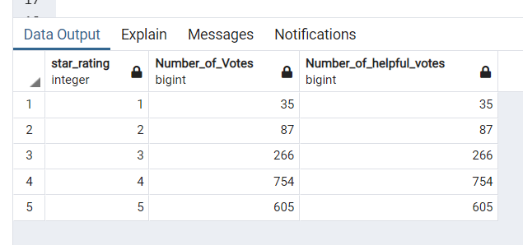
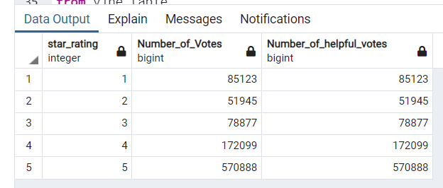
Watches Review Analysis – Count of Ratings for each Dataset
Vine Data
Non-Vine Data
As it can be inferred from the two tables that all votes were considered helpful and there is a fair distribution of star ratings among both datasets.

Slide 3
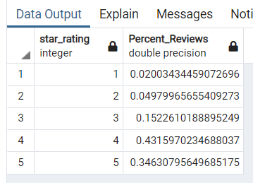
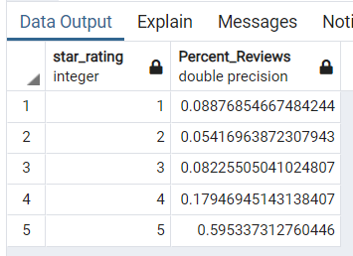
Watches Review Analysis – Percent of Each Rating
Vine Data
Non-Vine Data
Even though the percentage of reviews is not similar for both and vine users and non-vine users - It cannot be inferred that Vine-user reviews are trustworthy. More information will be needed to determine the trustworthiness of a Vine user as we have no in-put on if they are reviewing the same product. Having said that – Fewer Vine users give a product low ratings than non-Vine users.

Slide 4
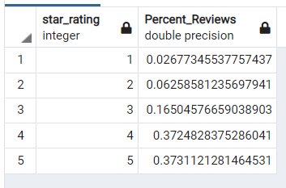
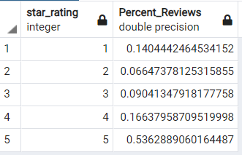
Wireless Review Analysis – Percent of Each Rating
Vine Data
Non-Vine Data
Reviewing another dataset it seems to be remarkably similar in terms of percentages for Vine-User ratings which could be further investigated. If this is a pattern across all datasets then one could determine that vine-user reviews are not trustworthy.

